Slide 1
Operational Purpose
Operational Purpose Statement
Our operational purpose is to enable and accelerate the corporate mission of reducing healthcare costs while improving health through high-quality, cost-effective care.
We do this by delivering responsive, efficient, and innovative operational support that empowers every department to perform at its best.
We are committed to:
Driving operational excellence through optimized processes, resource stewardship, and continuous improvement.
Fostering a culture of innovation, where bold ideas are encouraged and breakthroughs are celebrated.
Maintaining a resilient and responsive infrastructure that adapts to change and supports strategic growth.
Connecting every operational role to the broader mission, ensuring that all team members understand how their work contributes to the success of our clients and the health of our communities.

Slide 2
Agenda
Technology
Security
Distributed Workforce
DTE Implementation Strategy
Group Implementation Strategy
Our Service Model
Group Administration
Hospital Integration / Connectivity
DTE Performance / Plan Performance
Open Discussion / Take Away Items / Next Steps
Notes:
Patrick

Slide 3
Technology
Technology Stack:
Microsoft-based: .NET, SQL Server, Azure.
Secure hosting: IIS in DMZ network.
DevOps: Azure DevOps for lifecycle management.
Web presence: WordPress + SiteGround.
Cloud Based Architecture
Hybrid Cloud Model: We operate across Microsoft Azure and Expedient Cloud, supporting scalable, secure hosting for applications and data.
Cloud-Native Design: Our architecture leverages Azure DevOps, Microsoft 365, and Genesys Cloud for rapid deployment, centralized access, and enterprise-grade reliability.

Slide 4
Security
Zero Trust: Least-privilege, just-in-time access.
Cloud Secure: Compliant cloud data center with centralized secure edge controls.
MFA Only: Authenticator app required.
24/7 SOC: Real-time monitoring & response.

Slide 5
Distributed Workforce
An Intentionally Distributed Workforce:
KBA Claims Administrators and Customer Service Reps were first to go to a remote work model in 2001
As technology advanced KBA continued to steer more positions into a Distributed status
As of the start of the March 2020 Pandemic KBA had over 80% of the workforce working remotely, and 95% able to work from home.
ADVANTAGES:
Improvement in attendance, tardiness, and availability
Protection from regional or localized outages
Employee satisfaction and award-winning work life balance
Ability to recruit talent nationally, vs. regionally
CONTROLS:
HIPPA compliant workforce management tools
Measured and actionable performance and production standards
Benchmarking for Productivity, Focus, and Collaboration Activities
Proactive system monitoring and individual coaching opportunities

Slide 6
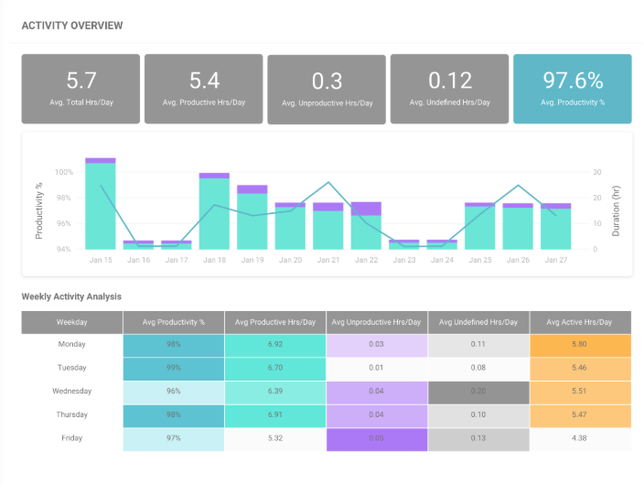
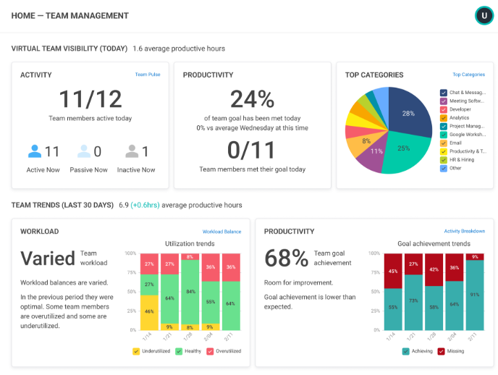
Workforce Management

Slide 7
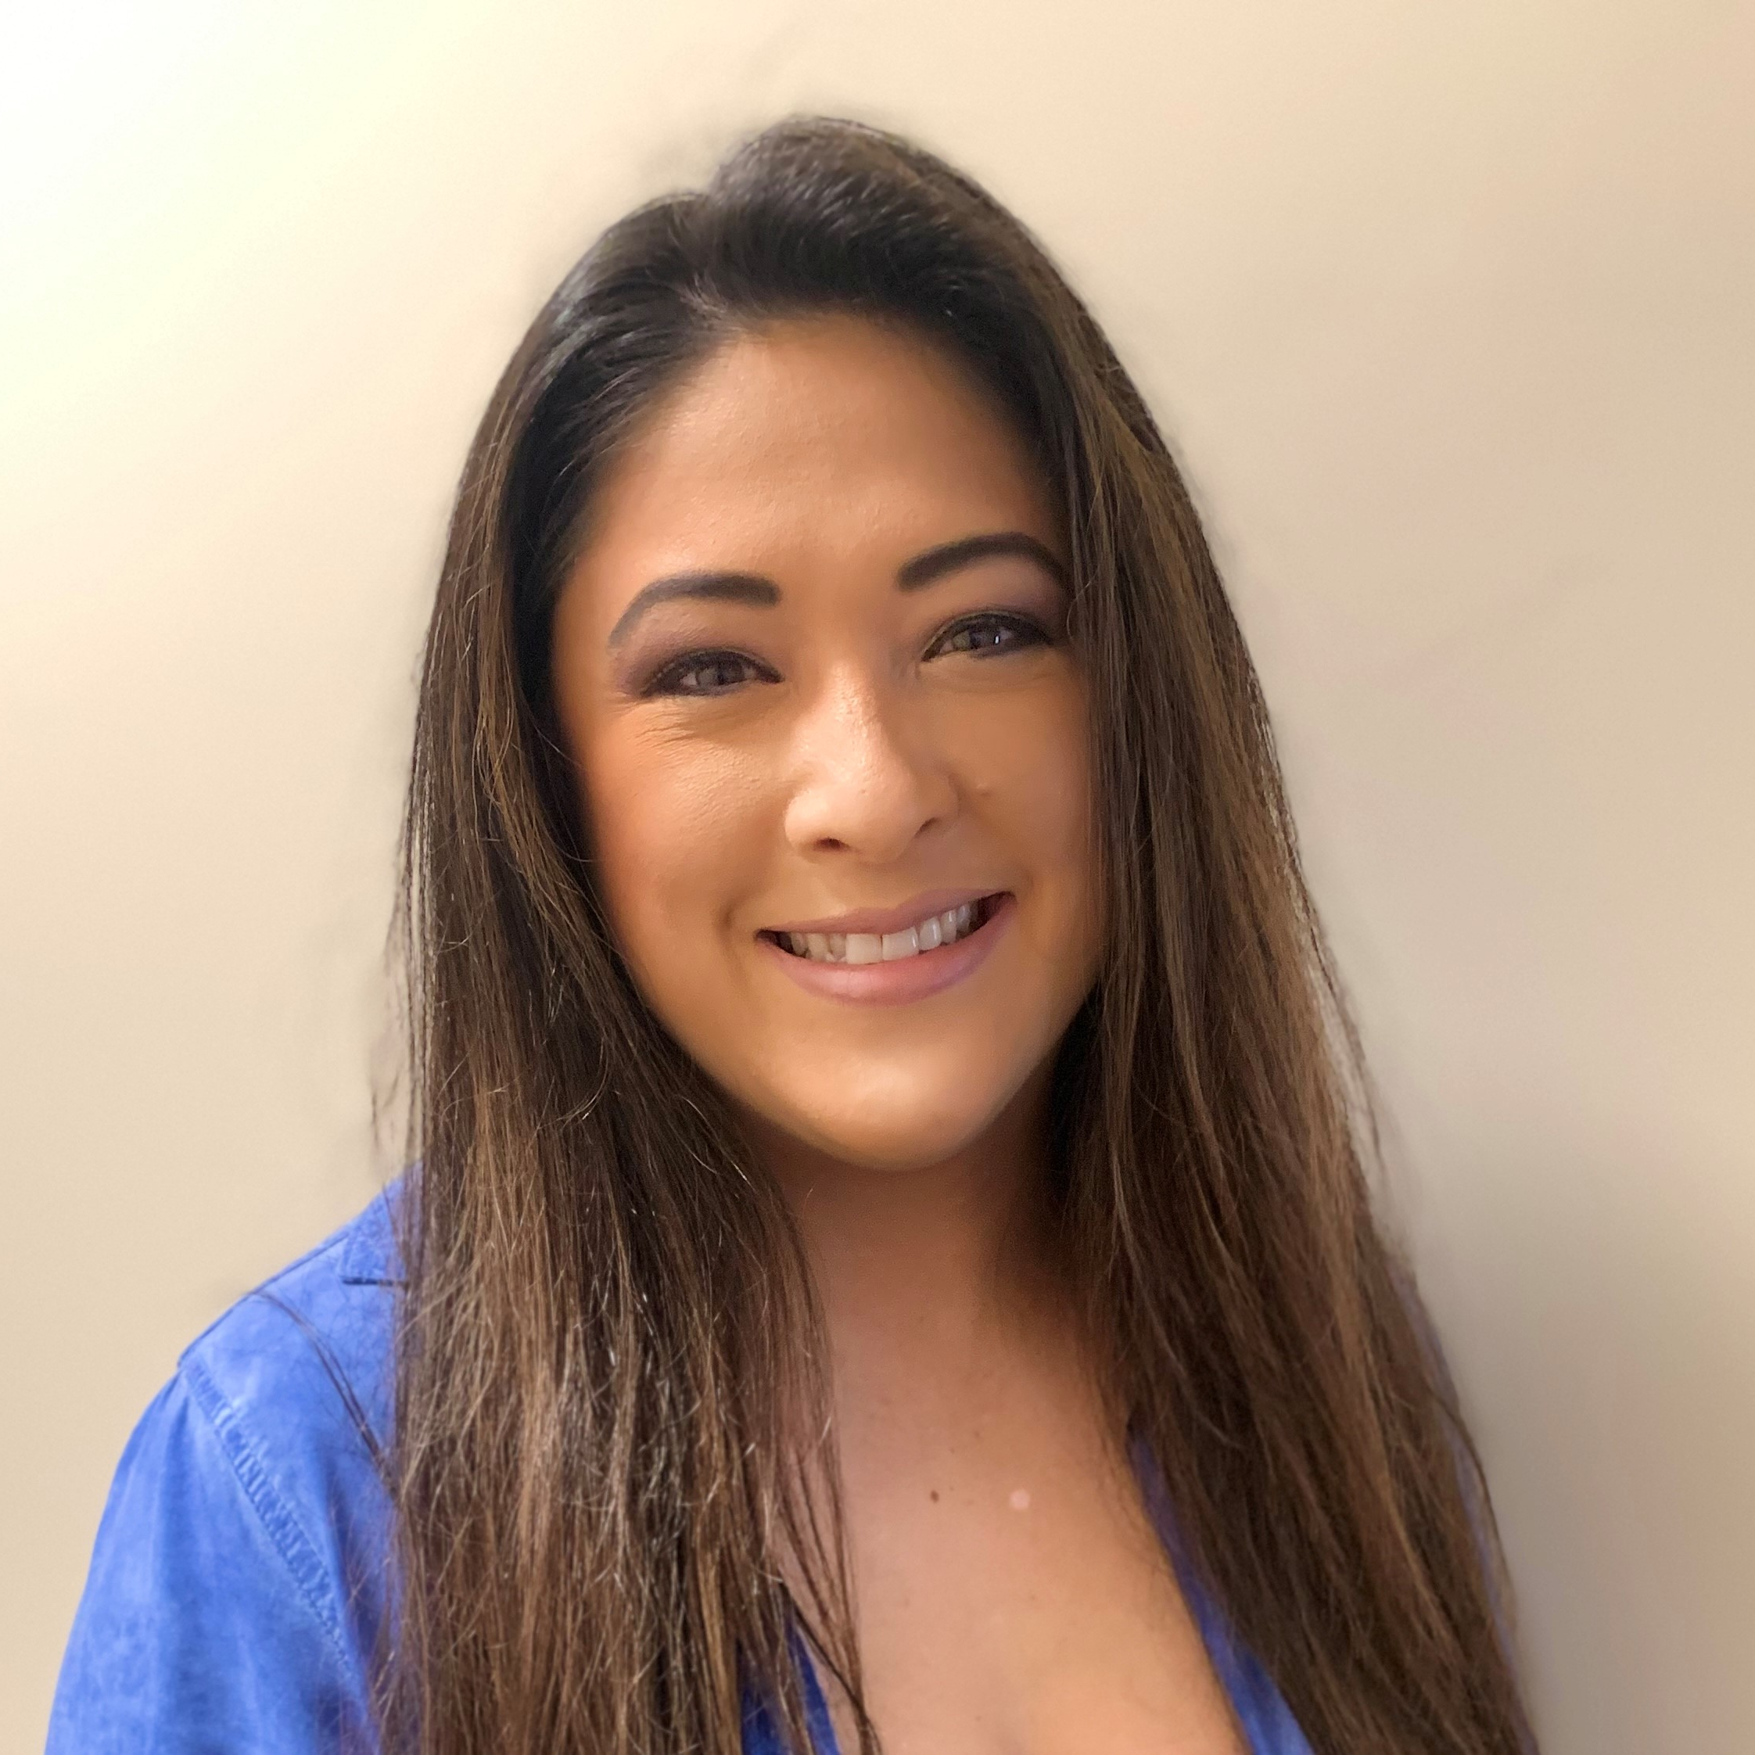
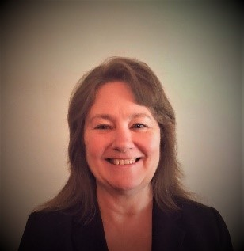
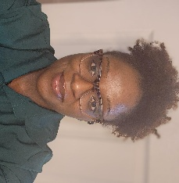
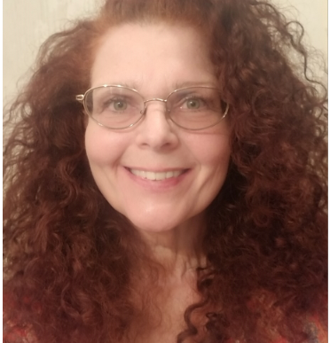
DTE Implementation
Team
Director, Implementation and Network
I joined Key Benefit Administrators in 2000 and have been in the Health Insurance Industry for 20+ years. My focus has been Leadership in Operations, Carrier and Provider Network Relations and Implementation Management.
Office: (803) 323-7974 | Email: Christine.Vinesett@keybenefit.com
Christine Vinesett
Network Operations Lead
Julie Caskey joined Key Benefit Administrators (KBA) in 2021. Julie brings an extensive background with 30+ years in the Health Insurance Industry. Julie’s focus has been in Provider Network and Relationship Management.
Office: 317-712-4003 | Email: Julie.Caskey@keybenefit.com
The DTE Implementation Team is responsible for the overall management of the DTE project plan for the DTE Network and KBA Administrative Operations.
We are always excited about new partnerships and look forward to developing a solid foundation to build upon.
Julie Caskey
DTE Implementation and Relationship Coordinator
Deja joined Key Benefit Administrators in 2023 and has been in the Health Insurance Industry for 10 years. Deja’s focus has been in Provider Network and Relationship Management.
Office: 803-396-4836 | Email: Dejanetta.Pettaway@keybenefit.com
Dejanetta (Deja) Pettaway
DTE Implementation and Relationship Coordinator
Darlene Grindstaff joined Key Benefit Administrators in 2014 and has been in the Health Insurance Industry for 11 years. Darlene’s focus has been in Implementation, Provider Network, and Relationship Management.
Office: 803-396-4784 | Email: Darlene.Grindstaff@keybenefit.com
Darlene Grindstaff
Notes:
Patrick

Slide 8

DTE IMPLEMENTATION TIMELINE
GO LIVE!!
MONTH 3-6
Group Marketing Collateral
Sales Operations
KBA TPA Operations
MONTH 1-3
DTE Name, Logo & Branding
DTE Marketing and Website
Network Setup
Provider Setup
MONTH 1-2
Business Contracts and Agreements
Network Contracts and Agreements
Information Technology
Included: SWHR Implementation Guide

Slide 9
DTE IMPLEMENTATION OVERVIEW
Phase 1 | Phase 2 |  | Phase 3
DTE Network Setup | DTE Marketing & Website Setup | DTE Provider File Setup | Group Sales & Plan Design Setup | Group Administration Setup
☐ Legal Contracts and Agreements | ☐ DTE Name Established | ☐ Provider data and file analysis | ☐ Group Sales and Marketing Strategy | ☐ Proposal system setup
☐ Security and Compliance review | ☐ DTE logo and messaging | ☐ Provider file requirements | ☐ Group Sales collateral | ☐ Group Implementation and Renewal Collateral
☐ Secure email connection - Transport Layer Security (TLS) | ☐ DTE Marketing Collateral | ☐ Provider file transfer | ☐ Group plan design and benefit structure | ☐ Administration system programming (DTE product, plan design, billing, distribution, extract files)
☐ Secure file and reporting connection - Secure File Transfer Protocol (SFTP) | ☐ DTE Website URL (domain) | ☐ Provider file programming and website testing | ☐ PBM plans and benefits review | ☐ Claims adjudication system programming
☐ Network review of providers, specialties and sub-specialties | ☐ DTE Website design and content creation | ☐ Provider maintenance file established | ☐ PBM structure analysis (systems, data import, data export, billing and invoicing) | ☐ Fulfillment programming
☐ Network contracting and pricing analysis | ☐ DTE Website provider portal setup | ☐ DTE Website review for launch | ☐ PBM file structure programming and testing (claims, accumulators, elig, invoice feed) | ☐ Customer Service programming
☐ Network fee schedule programming and testing |  |  | ☐ Reinsurance Carrier education on DTE | ☐ Complete End to End Testing
Network launch | Website launch |  | Group Sales launch
Notes:
Patric

Slide 10
.
A Collaborative and Dedicated Strategy
Dedicated Implementation Team:
Specialized Leadership: Each group is assigned a Director, Manager, Lead, and Coordinator for focused execution.
A Project Framework: Structured setup, finalization, confirmation, and go-live ensure smooth transitions.
Measurable and Transparent Status: From lead to sold case, and through Implementation Salesforce tracks all critical milestones and is monitored through real time dashboarding.
Client-Centric Coordination: Kick-off meetings align stakeholders with tailored timelines and materials.
Operational Readiness: Proactive management of eligibility, billing, ID cards, and vendor integration.
Improved Outcomes: A departmental approach drives consistency, faster issue resolution, and higher client satisfaction
Group Implementation Approach
Group implementations teams have members from both the Implementation Department and Client Relations Team.
KBA is committed to delivering a “WOW” level of customer service and our team will ensure a smooth and timely transition to KBA.
Dedicated Service Team:
Early Engagement: Client Services is looped in during the kickoff phase to align expectations and ensure seamless communication with the group.
Dedicated Support: A Client Services representative is assigned to each group to provide continuity and personalized assistance throughout onboarding.
Issue Resolution: The team proactively monitors onboarding milestones and escalates any delays or concerns to ensure timely resolution.
Training & Resources: Client Services facilitates access to training materials, system walkthroughs, and support documentation for group administrators.
Post-Go-Live Follow-Up: After launch, Client Services continues to engage with the group to confirm satisfaction and address any lingering setup needs.
Notes:
Patrick/Nicole

Slide 11
GROUP IMPLEMENTATION OVERVIEW
Phase 1 | Phase 2 | Phase 3 | Phase 4
Implementation Begins | Group Details - Open Enrollment, Eligibility Setup, ID Card, Banking, and Vendors | Finalize Setups - Open Enrollment, Eligibility, ID Card, Banking and Vendors | Confirmations - Fulfillment, Post Implementation Planning, GO LIVE!
☐ Identify key group contacts and their Roles and Responsibilities. | ☐ Confirm Open Enrollment dates. | ☐ Introduce Billing and Customer Service Teams. | ☐ Confirm eligibility loaded.
☐ Review contracts and electronic signature process. | ☐ Discuss materials needed for Open Enrollment and expected delivery. | ☐ Process Open Enrollment eligibility. | ☐ Confirm fulfillment mail date.
☐ Confirm Signor information. | ☐ Discuss COBRA Administration. (if applicable) | ☐ Finalize COBRA Administration setup. (if applicable) | ☐ Confirm COBRA letter and packet mail dates. (if applicable)
☐ Establish meeting schedule, frequency and set target dates. | ☐ Discuss Customer Service setup. | ☐ Finalize EZ Benefits setup. | ☐ Confirm all group setups are complete.
☐ Begin KBA Client Profile. | ☐ Review EDI Setup and initial eligibility file submission. | ☐ Finalize ID Card setup. | ☐ Confirm plan document has been signed.
☐ Request prior plan document. | ☐ Schedule EDI meeting. (if applicable) | ☐ Finalize banking setups. | ☐ Deliver 1st Months Invoice and finalize.
☐ Review plan document, benefits and discuss changes. | ☐ Review EZ Benefits platform. | ☐ Finalize claims and EOB setups. | ☐ Deliver final reinsurance contract.
☐ Request claim file and accumulator data. | ☐ Discuss ID Card setup, approval process and delivery expectations. | ☐ Finalize PBM Implementation. | ☐ Discuss reporting needs for plan year.
☐ Review Fee Schedule, Implementation Fee. | ☐ Discuss Banking and Funding setup for monthly premiums and claims. | ☐ Finalize Plan Document. | ☐ Complete full transition to Client Relationship Team for administration.
☐ Discuss Notice of Termination to prior carrier and obtain copy. | ☐ Discuss frequency of check runs, large dollar claims review, exception process and EOBs. | ☐ Review status of EDI setup. (if applicable)
 | ☐ Discuss monthly premium billing preferences.
 | ☐ Begin PBM Implementation and schedule meetings.
 | ☐ Discuss vendor setup process.
 | ☐ Review special programs. (if applicable)
Live Group Administration

Slide 12
Your Service Team
Availability & Dedication
A dedicated and customized service team will be assigned to each account, with a focus on a WOW level of availability and responsiveness to their inquiries and needs. Our teams strive for partnerships that begin with trust and confidence.
Superior Consulting
Expert consulting services are provided based on industry knowledge paired with the goals of the client and the objectives of the Direct to Employer platform. Data analytics are reviewed with clients quarterly and measured for key indicators, trends and successes.
Custom Solutions
An intimate knowledge of each client’s goals, challenges and industry allows us to partner with them to analyze the benefit plan offering and execute specific risk and cost management strategies to fit their needs.
Notes:
Nicole

Slide 13
The Customized Development of the KBA Service Team
Client Service Team Development Process
Client Team and KBA Introduction and Acquaintance
On site visit to the client by VP, Client Relations
Education on Roles of the HR Team and Their Goals and Objectives
Collaboration on Wants and Needs of the HR Team to Include Reporting, Data and Support Expectations
Identify the Frequency and Format of In-Depth Plan Performance Reviews and Analytics
Tailored KBA Service Team
Service Team will be Customized and Assigned Based on the Wants, Needs and Expectations of Each Client, as Well as the Assessment Above.
Identifying Key Characteristics of the Client’s Leadership and HR Team in Conjunction with the Evaluation of the KBA Team to Apply the Appropriate Level of Expertise and Support
Continued Team Growth
As the Process of Consulting, Data Analytics and Day to Day Service Progress, Additional Resources Will Be Assessed and Introduced to Clients as Needed

Slide 14
What Clients Can Expect From Our Service Team
Consistent and Structured Communication Touchpoints
Quarterly Meetings with a Focus On:
Plan Performance
Risk Management and Reporting
Health and Wellness Initiatives
Analytical Analysis with Recommendations and Solutions Developed Upon the Specific Client Data and Objectives
3 Year Healthcare Strategy
Partnering With Each Client to Develop a 3 Year Healthcare Strategy Based Upon Plan Utilization and Costs, Provider Steerage, Plan Design, Wellness Initiatives and Employee Engagement
Compliance Guidance
Recommendations and suggestions based on required compliance items

Slide 15
KBA DEDICATED TEAM ROLES
Benefit Consultant (BC)
Average Tenure of 5 Years
Delivers strategic consultation to the client in conjunction with the CVP, with a focus on reporting. Upon renewal season, the BC will assist in preparing renewal proposals that will include services, fee structures, time frames and coordinate/conduct employee enrollment meetings as needed.
Client Vice President (CVP)
Average Tenure of 15 Years
Dedicated individual that delivers solutions for client needs, driven by their data. The KBA CVP will be knowledgeable about their demographics, goals and plans, as well as the state of health of their membership. Through unparalleled analytics, the CVP will illuminate the intelligence of the data. They are there to coordinate and conduct plan performance reviews that include not only observations, but also provide meaningful recommendations. The CVP can also assist with employee enrollment meetings, presentations and announcement materials. The CVP will stay informed on client issues and initiatives, tracking all information related to the account.
Account Representative (AR)
Average Tenure of 3 Years
Will service the account by addressing their day to day needs and providing consistent communications, follow-up services and monitoring the account. They will oversee the new case implementation and renewal processes alongside of the KBA operations team. The AR will be responsible for the distribution of monthly reports, facilitating plan design changes and obtaining signatures for Plan documents / amendments. Additionally, they will be able to help manage funding including ACH transfer of funds and various other inquiries.

Slide 16
ADDITIONAL KBA TEAM MEMBERS
On-Site KBA Support
On-site resource for members to ask questions surrounding benefits, eligibility or claims questions, as well as a resource for HR for plan administration support.
Economist/Analyst
George Avery, PhD, MPA. Dr Avery has a doctorate in Health Services Research, Policy, and Administration from the University of Minnesota and has been a professor at Purdue University and the University of Minnesota Duluth. He has authored six book chapters, over 20 peer-reviewed journal articles, and has served as an advisor for the Indiana Office of Rural Health, the Centers for Disease Control and Prevention, the Department of Defense, and the United States Environmental Protection Agency. He has over 30 years’ experience in public health, health economics, and econometric analysis.
16

Slide 17
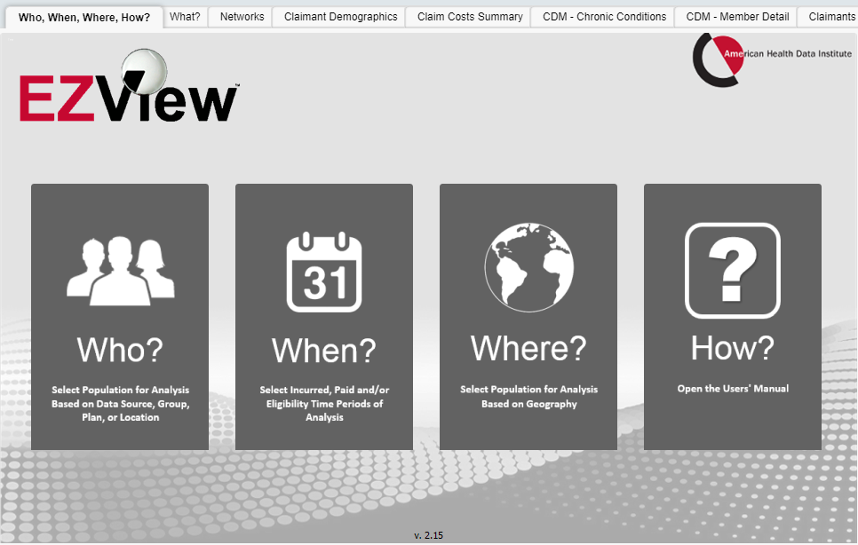
Analytics Engine - EZViewSM
Turning Data into Actionable Intelligence
17

Slide 18
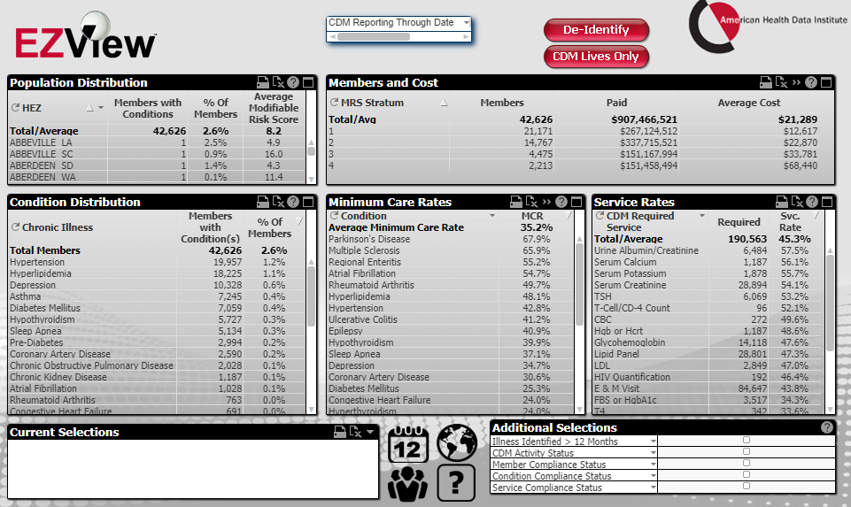
All Patient, Provider, and Location Data Regardless of Network Affiliation
Identify the sickest of the sick
Monitor Compliance with Nurse Coaching and Triage to Providers
Identify Every Chronic Condition by Patient for Intervention
Regimens of Care for Chronic Illnesses

Slide 19
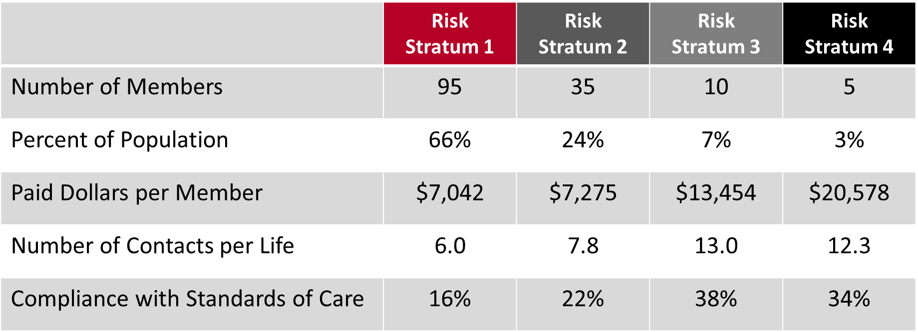
THE “PHOTO” MOMENT Real discussions with the employer discussing the health of their population
10

Slide 20
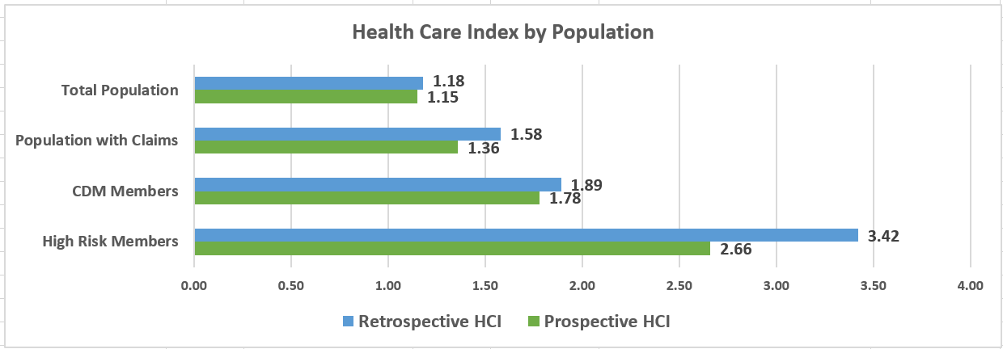
Actual Data that Displays What is Being Done to Change Behaviors and Improve Health

Slide 21
Employer Experience
Electronic Eligibility
Streamlined Data Exchange – Seamless EDI connections with benefit administration partners for improved accuracy and efficiency
Proven Experience – 100+ successful partner engagements
Standardized Approach – Simple file layout for consistent data accuracy
Dedicated Support – Assigned EDI coordinator to manage implementation and ongoing needs
Efficient Implementation – Simple, proven project plan from introduction to production in just 3–6 weeks

Slide 22
Employer Experience
Web Portal Eligibility
Self-Service Updates – Employers can make eligibility changes anytime without manual submissions or waiting on support staff
User-Friendly Design – Intuitive, easy-to-use interface for efficient management of employee eligibility
Operational Efficiency – Reduces administrative workload while improving accuracy of eligibility data
Comprehensive Online Features
Online claims look-up
Online invoice delivery with automated notifications
Eligibility detail inquiry
Provider network look-up
Express requests & ID card requests
Forms and plan document retrieval
Full benefit administration functionality (for non-EDI clients)
Add/remove dependents, update coverages, review eligibility status

Slide 23
Billing – Premiums and Claim Funding
Dedicated Billing Specialist​
Each client has a dedicated specialist providing personalized billing support and promptly addressing issues.​
Advance Premium Billing​
Premiums are billed in advance on the 15th, allowing clients to plan finances and avoid missed payments.​
Transparent Communication​
Proactive communication from billing specialists fosters transparency and builds client trust.​
Financial Stability and Satisfaction​
Consistent billing schedule and support enhance financial stability and improve client satisfaction.
Claim Funding
Funding requests are provided in advance of check cycles and are set with ACH pull or push options.

Slide 24
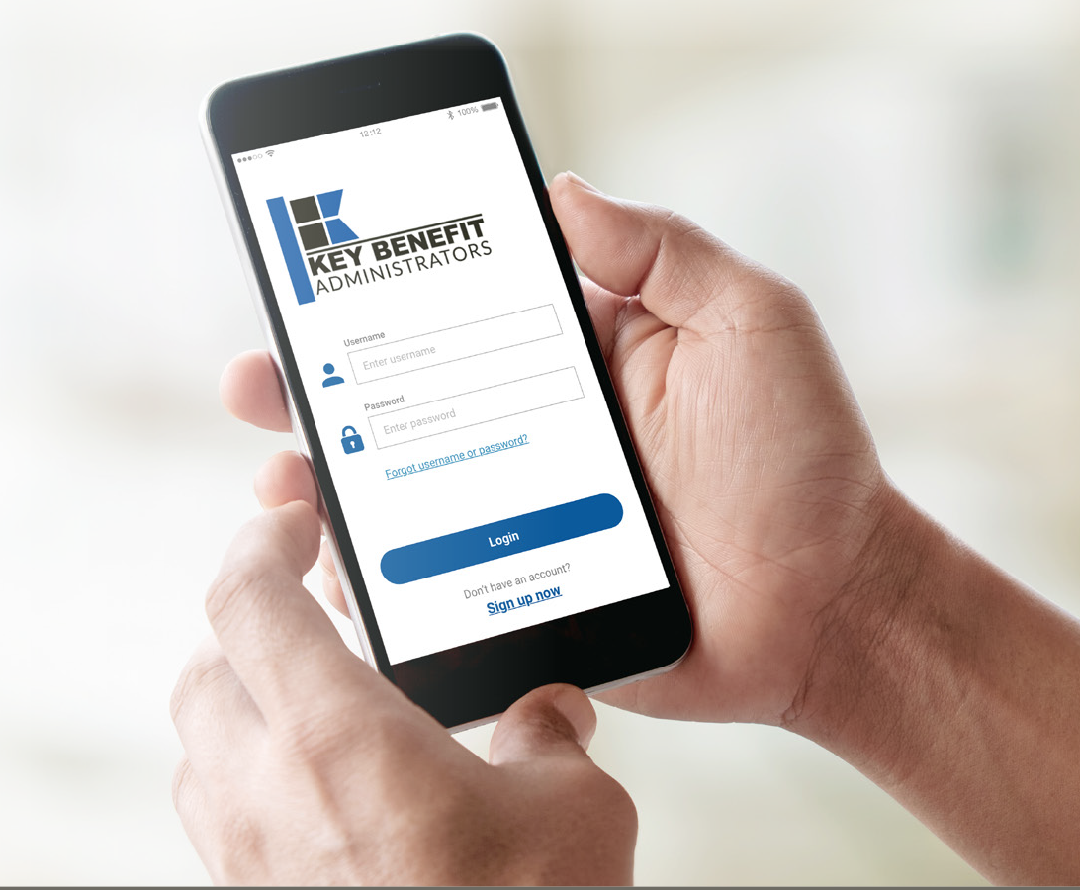
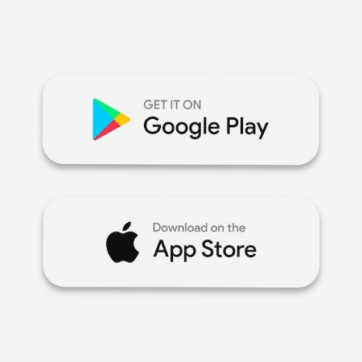
Web Portal and Mobile Application
Gives you accessibility to your benefit plan information, claims data, eligibility details and much more!
Biometric Login for ease of access (Fingerprint & Facial Recognition)
Simplified Accumulator View
Recent Claims Summary and Full Detail
Benefit Information
View/Request an ID Card (Display - Print – Fax – Email)
SSO directly to Vendor Solutions
Rx Price Comparison and Pharmacy Discount Programs (if applicable)
Express Requests to Customer Support
Push Notifications (Mobile App)
Gives you accessibility to your benefit plan information, claims data, eligibility details and so much more!
• Dashboard with menu options
• Claim Status
• Benefit Information
• View/Request an ID Card
• Geofencing
• Push Notifications
• Rx Price Comparison
• Customer Service

Slide 25
Measuring Success: Customer Experience Key Performance Indicators
Metric | 2025 YTD | Industry Benchmark | How We Compare
Abandonment Rate | 1.04% | 3–5% (acceptable), <2% (best-in-class) | Excellent 👏
Average Speed of Answer (ASA) | 17 seconds | <28 seconds (typical target); ~3 min in healthcare BPO | Excellent 👏
SLA (80% ≤ 30 sec) | 90.00% | 80% in 20–30 seconds (standard) | Above target ✅
Average Handle Time | 7 minutes 47 seconds | 4–6 minutes typical; 7–8+ mins for complex TPA calls | Higher than industry, but expected
After Call Work (ACW) | 49 seconds | 30–60 seconds typical | Within range 🟢
Quality Audits (Email, Chat, Soft Skills, Procedural) | 99%+ | 95–97% considered strong | Outstanding 💯
Industry-leading responsiveness
1.04% abandonment and 17 s average speed of answer—minimal dropped calls, maximum access.
Outstanding quality & access
90% of calls answered within 30s (vs. 80% target) and 99%+ audit scores across voice, email & chat.
Balanced efficiency & depth
Handle time reflects the detailed, compassionate TPA support your members need.
Notes:
As a Third-Party Administrator in a complex benefits environment, our contact center isn’t just meeting standard benchmarks—it’s surpassing them. We’re seeing an industry-leading 1.04% abandonment rate and are answering calls in just 17 seconds on average, which translates to an exceptional member experience and minimal dropped connections.
Our 90% service-level compliance further underscores our commitment to rapid access—far above the 80% industry target—while our audit scores in excess of 99% across soft skills, procedures, email, and chat demonstrate rock-solid quality assurance.
Although our average handle time is slightly higher than the 4–6-minute norm, this reflects the depth of support required for detailed benefit inquiries, claim resolutions, and coordination of care. In short, we combine speed and quality to ensure that your members and providers receive prompt, accurate, and compassionate service every time they call.

Slide 26
What Our Members Are Saying: Real Feedback on Their Call Center Experience
“Ashlee was beyond wonderful at helping me resolve a months‑long issue.”
“She explained my claims in a way I could understand. Please give her kudos for a job well done.”
“Amy took the time to walk me through how to find in-network providers and explained the benefits clearly and patiently.”
“I called frustrated after a long day, and the representative was cordial, professional, and knowledgeable. She changed my mood with her calm voice – please acknowledge her!”
Our Agents advocate for our members…
“Michelle was a gift to me the day I called in. She took control and got everything going – amazing!”
Our Agents understand the Journey …
“Teresa was kind, helpful, and went above and beyond with superb customer service.”

Slide 27
Customized Plan Solutions for Complex Client Needs
Flexible Plan Designs
Customizable benefit structures to meet diverse organizational needs.
Streamlined plan management for operational efficiency.
Capable of high frequency plan change requirements.
Large Client Plan Process
In-depth analysis of current plan design challenges.
Compliance review of existing plan documentation.
Interactive Q&A to clarify benefit intent and administrative practices.
Strategic consultation based on plan review and claims data insights.

Slide 28
Training Overview
Diverse Learning Formats​
The LMS supports video tutorials, quizzes, discussion forums, and real-time feedback to enhance learning engagement.​
Active Trainee Participation​
An interactive environment encourages trainees to engage and retain knowledge effectively during their learning journey.​
Progress Monitoring and Adaptation​
Trainers can monitor progress, identify gaps, and customize content to meet individual learning needs.​
Scalable Training Solution​
The LMS provides a scalable and adaptive platform ensuring consistent instructional quality across the organization.
Mandatory Training Modules
Training includes legal, ethical and procedural aspects essential for insurance compliance.
Robust LMS System

Slide 29
Claims Processing Excellence
Delivering a positive member and provider experience starts with accurate, efficient, and transparent claims processing
Key Benefit Administrators leverages:
State of the art technology
Streamlined workflows
A team dedicated to first pass accuracy
Consistently:
Exceed industry standard turnaround times and quality metrics
Reduce administrative burdens
Maintain high member and provider satisfaction
Strategic Partnerships:
We partner with Smart Data Solutions for clearinghouse services to empower providers with electronic claims submission and transparency tools.
Currently 82% of our claim volume is received electronically.
Ongoing efforts to increase electronic submissions:
Analyze paper and non-electronic claims
Proactively engage providers for electronic claim setup
We also partner with top tier vendors to provide cost containment solutions to include:
Out of network discounts
High dollar bill reviews
Specialized networks for high-cost conditions such as transplants and dialysis.

Slide 30
Claims Statistics
Claims | Industry Standard | Corporate Goal | Self-Funded Medical Achieved*
Turn Around Time | 10 calendar days | 7 calendar days | 4.25 calendar days
% Paid in 10 days | 80% | 85% | 86.7%
Financial Quality | 99% | 99% | 99.6%
Payment Accuracy | NA | 95% | 97.4%
* Data achieved is for Jan-Jun 2025 calendar year
Our claims staff has an average of 14 years of experience.
Our team structure is intentionally designed to provide dedicated focus across specialized functions, enabling streamlined workflows and efficient claims processing.
Groups are provided with a dedicated claims specialist to handle escalated issues and concerns promptly.
The claims team works proactively to identify and resolve potential issues before they affect members, minimizing rework and reducing appeals.

Slide 31
KBA Claim Audits
Industry Claim Audits
Post Payment Reviews
Pre Payment Reviews
Claim Processed and Released
Claim is processed and paid
Claim Audited
After the claim has been paid, a post payment audit review is completed
Sent for Corrections
Costly adjustments are handled after the claims have been paid
Claim Processed
Processing completed by claim processor
Claim Audited
Claim not released until determined that it is correct
Sent for Corrections
If incorrect, sent to processor for correction and monitored
Claim Released
Once correct, claim released for payment
We target to audit 1.5%-2.5% of processed claims
Claims are selected with multiple criteria for review
Random
Processor Set Check Amounts
Group Maximums

Slide 32
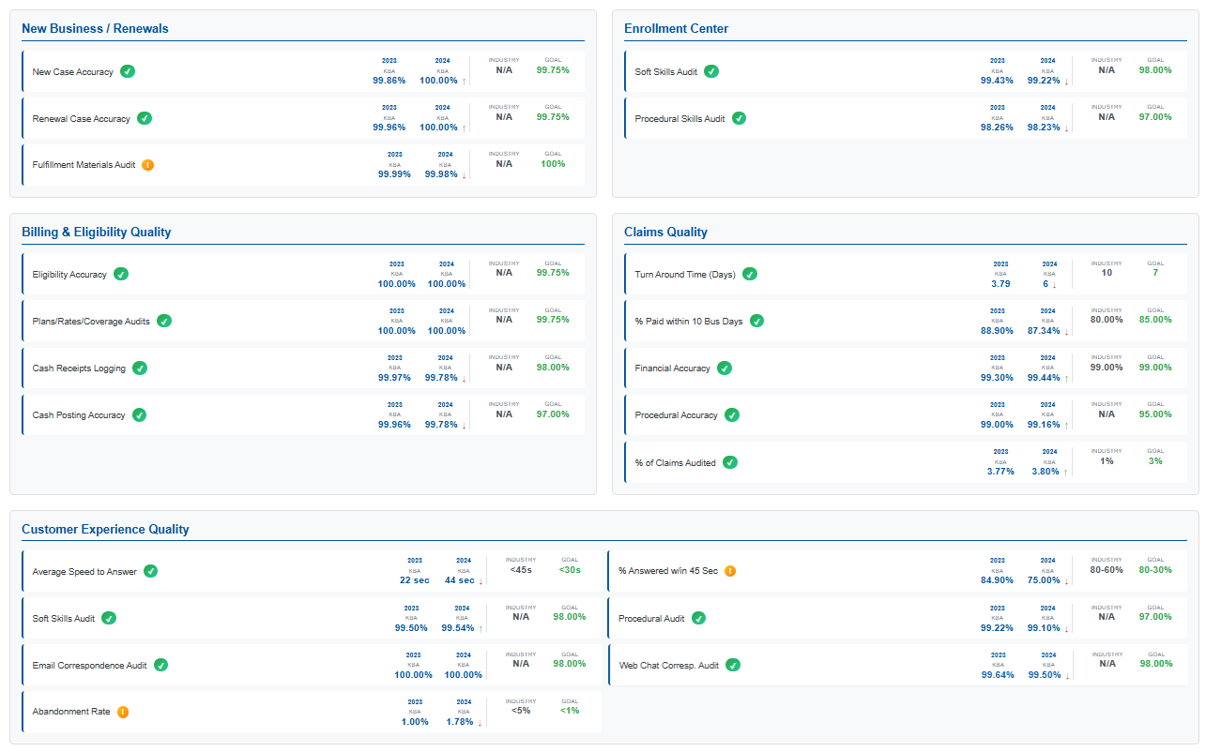



KBA 2023-2024 Total Quality Management Statistics

Slide 33
Hospital Connectivity
Provider Experience
Flexible provider payment options: EFT, Credit Card or Check
835 transaction sets available for enrolled providers
Option for no payment remittance for clients not requiring cash transactions.
DTE Performance Reporting
Sales Pipeline / Group Implementation / Network Performance

Slide 34
Discussion / Take Aways
Take inventory of follow ups
Set additional break out meetings as identified
Open discussion and wrap up

